Slide 1





Starlink : Satellite Internet Access
Lucas Baclé, Clément Géhin, 5 ISS A1

Slide 2
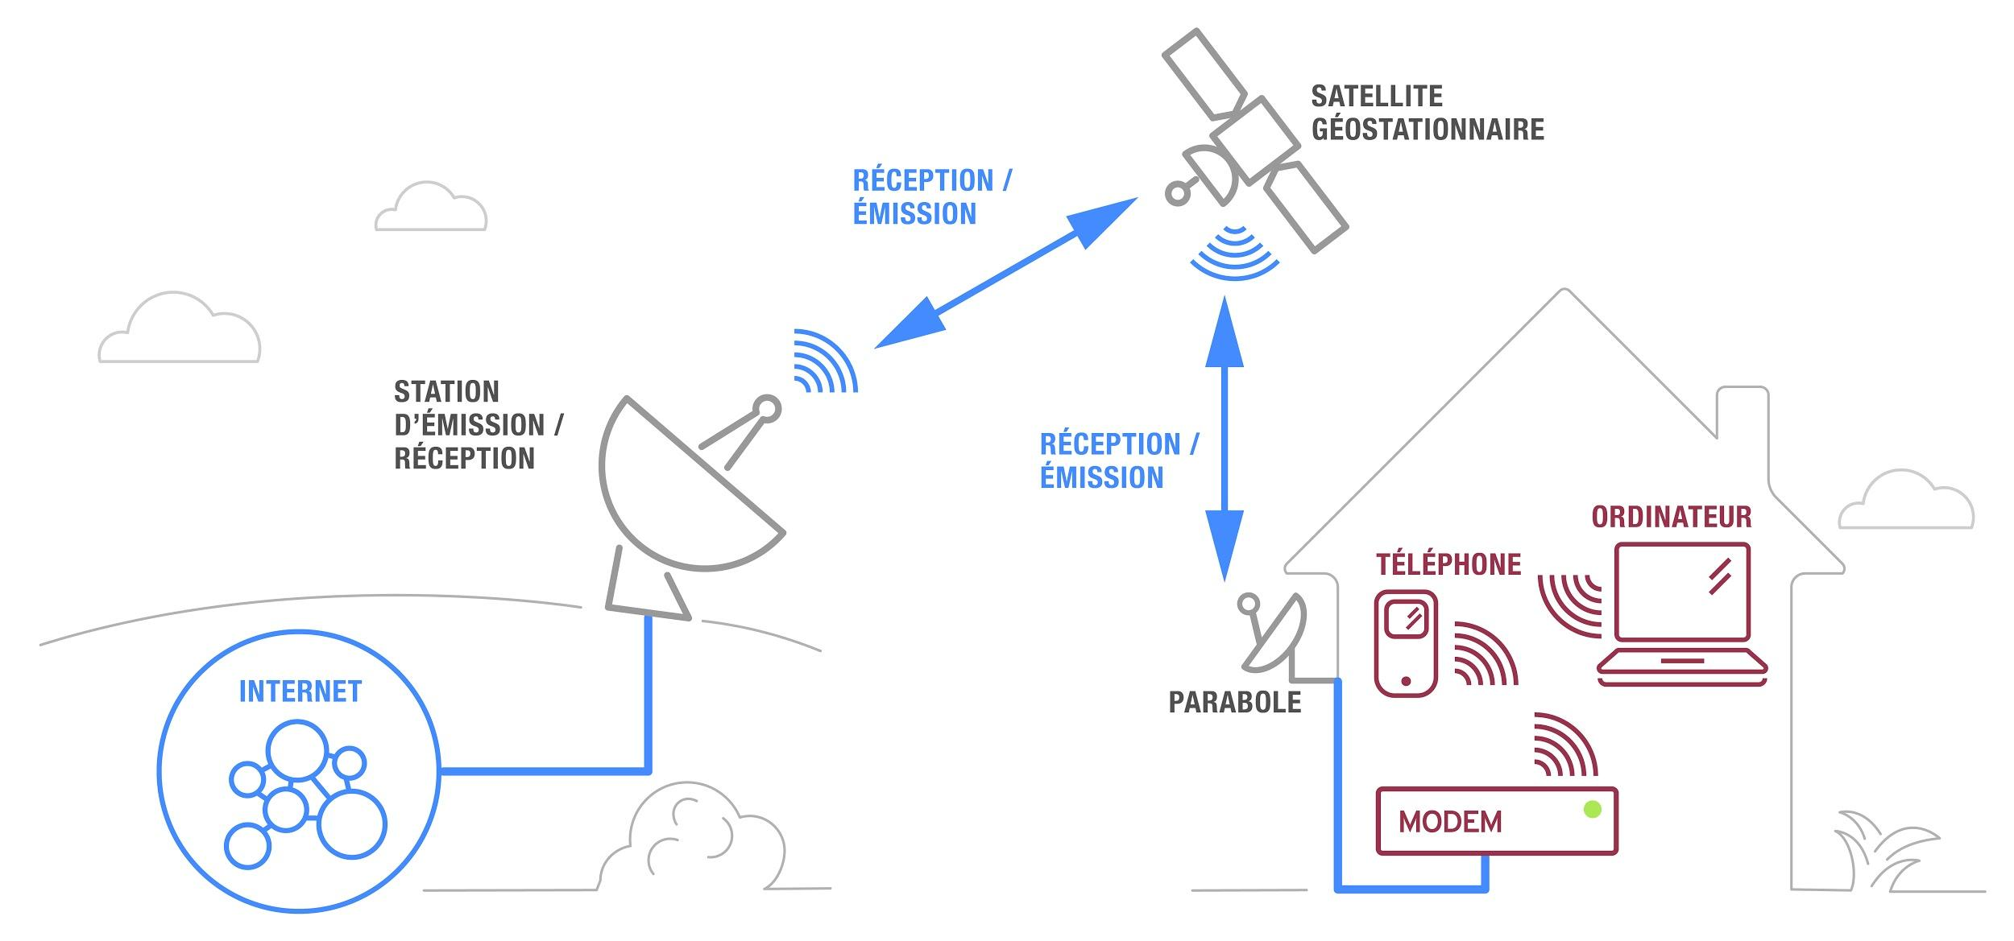
Lucas Baclé, Clément Géhin
What is Satellite Internet Access?

Slide 3
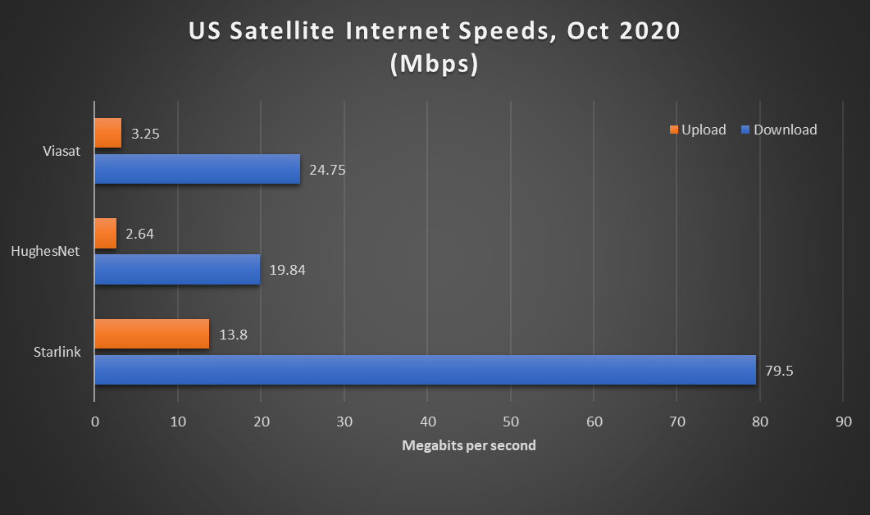
Lucas Baclé, Clément Géhin
What is Satellite Internet Access?

Slide 4
Lucas Baclé, Clément Géhin
A bit of history
early 1990s: World Wide Web invention
1994: Teledesic low orbit constellation project
early 2000s: Teledesic, Iridium & Globalstar failures
2003: first Internet-ready satellite (Eutelsat e-Bird)
2004: 1.5 Mbits/s downlink satellite (Télésat Canada Anik F2)
early 2010s: 15 MBits/s downlink satellites (ViaSat-1, …)
mid 2010s: new low orbit constellations projects (Amazon, SpaceX, OneWeb)
2018: launch of Starlink Tintin A & Tintin B first test satellites
October 2020: Starlink’s first public beta testing

Slide 5
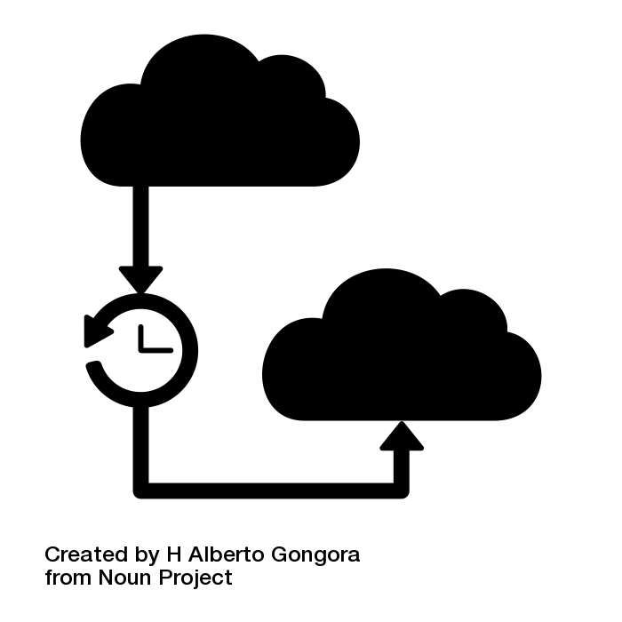


Lucas Baclé, Clément Géhin
Technical difficulties
High latency (≥ 600ms)
Limited bandwidth (ViaSat 2 260Gb/s)

Slide 6
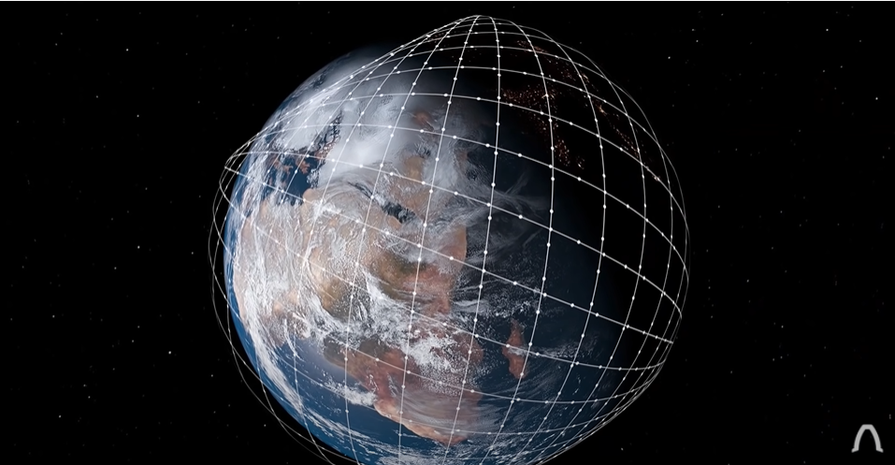
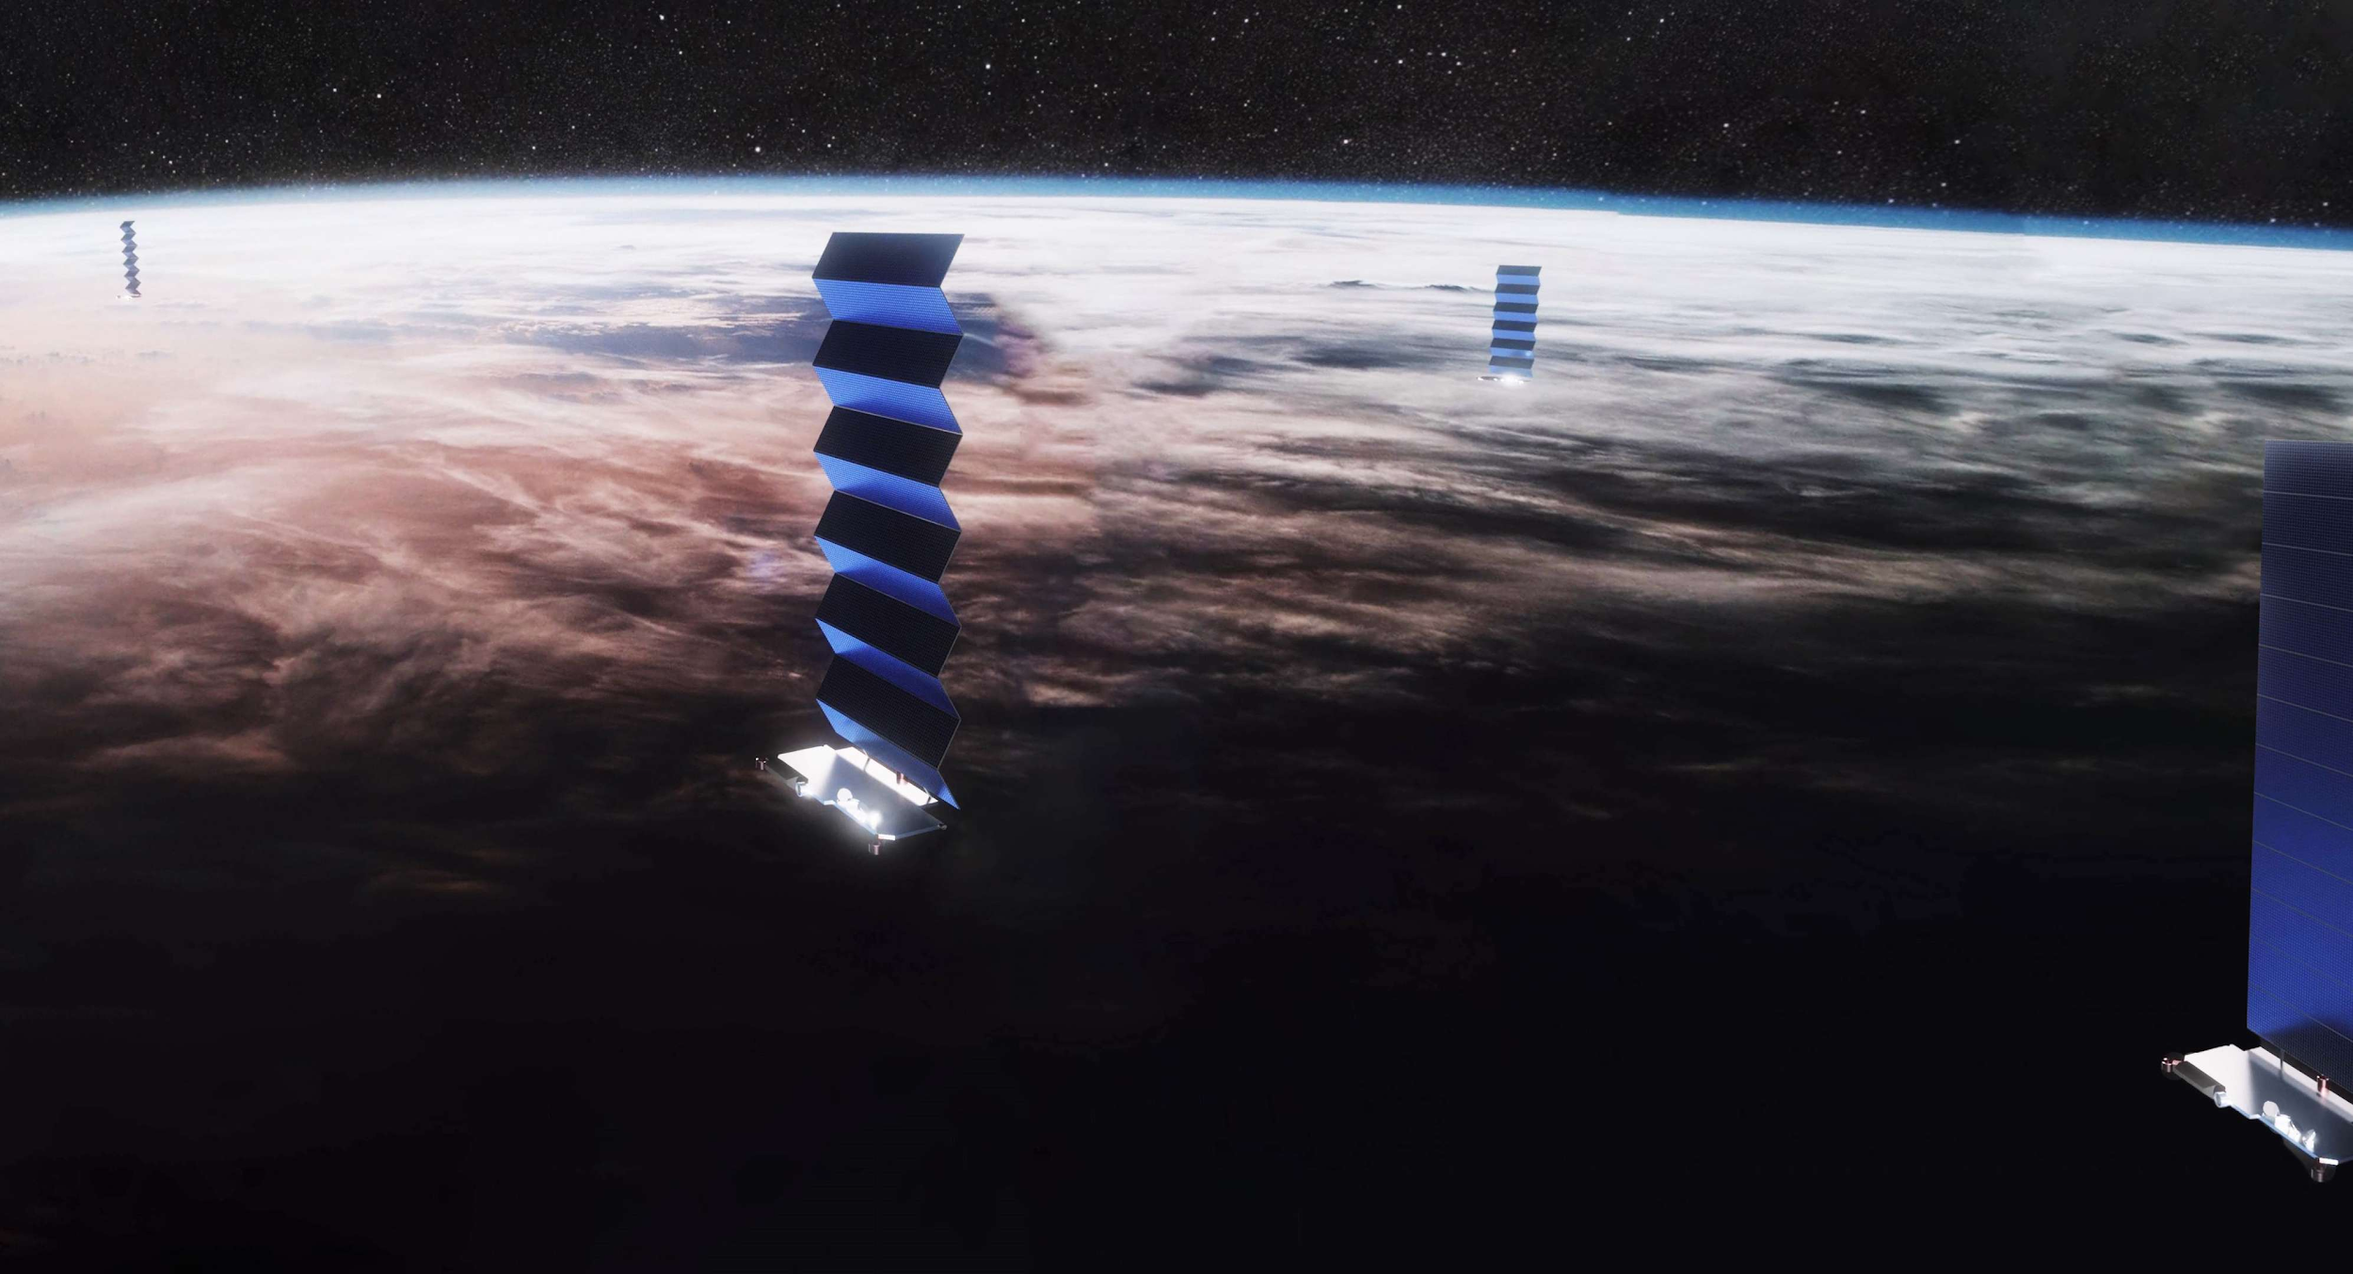
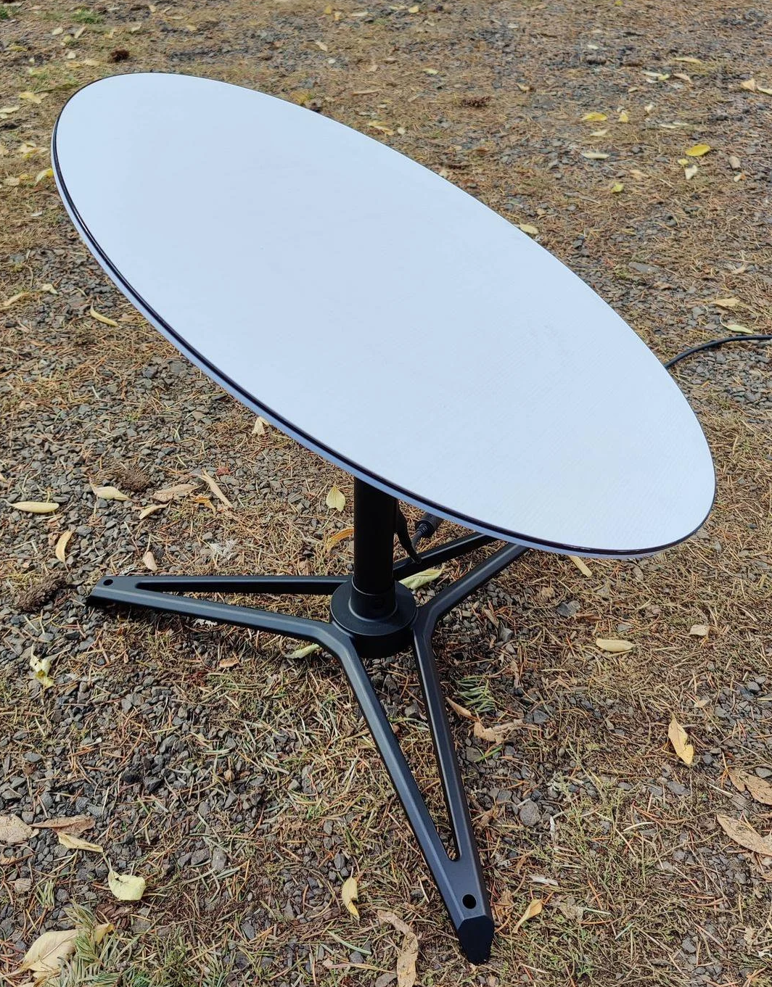
Lucas Baclé, Clément Géhin
Starlink: an overview
12 000 Satellites

Slide 7
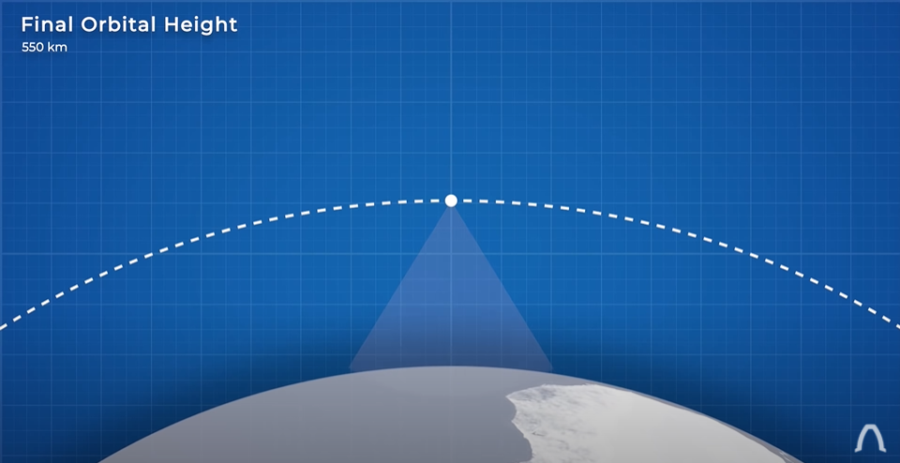
Lucas Baclé, Clément Géhin
Starlink: an overview
Low orbital height => Low latency

Slide 8
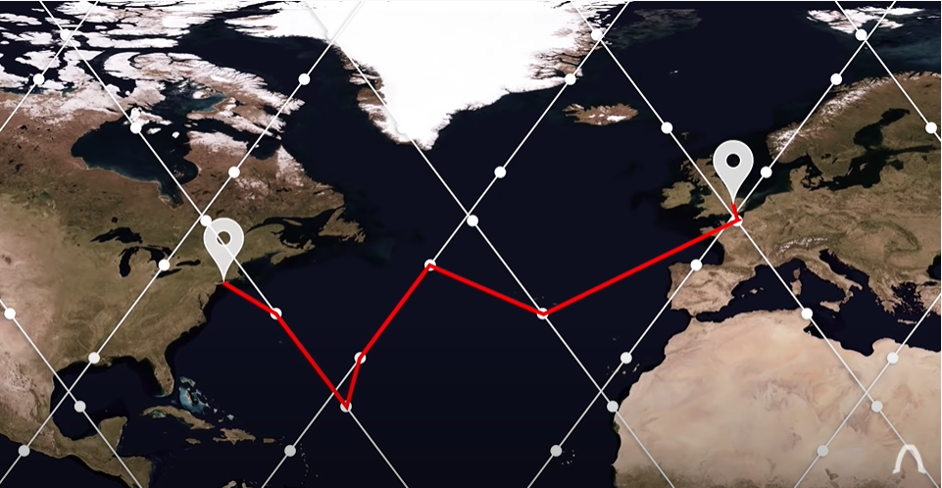
Lucas Baclé, Clément Géhin
Starlink: an overview
Evolving grid of transmission

Slide 9
Lucas Baclé, Clément Géhin
Starlink: an overview
Data race between fiber optic and Starlink
London to New York
Fiber Optic
Starlink
Use glass as laser transmitter
Optic to electronic conversion
Middle terminal needed
76.0 ms of latency
Use vacuum as laser transmitter
Phased array to transmission satellite to earth
Starlink pizza box sized antenna
43.0 ms of latency

Slide 10



Lucas Baclé, Clément Géhin
Starlink: an overview
Potential Clients
Every human on earth
Bank and stock exchange
Price : 200 $

Slide 11
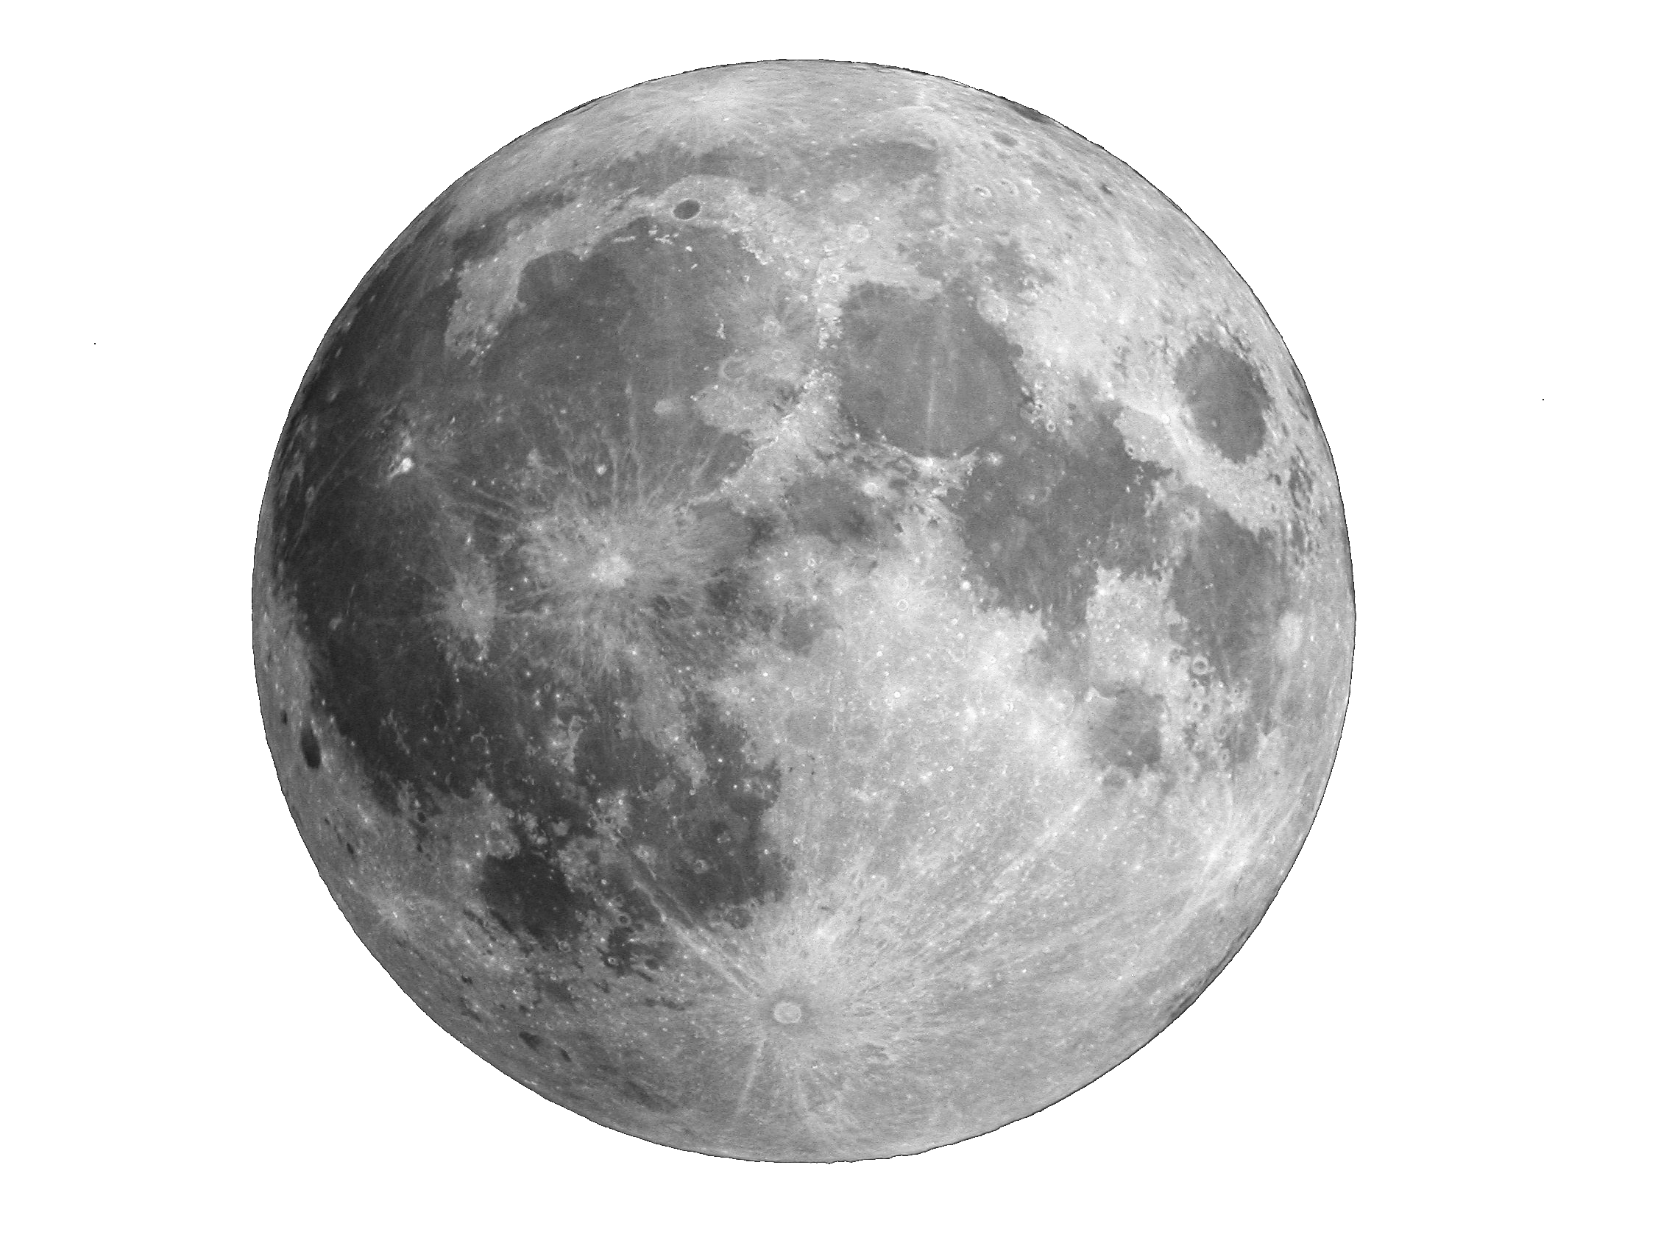
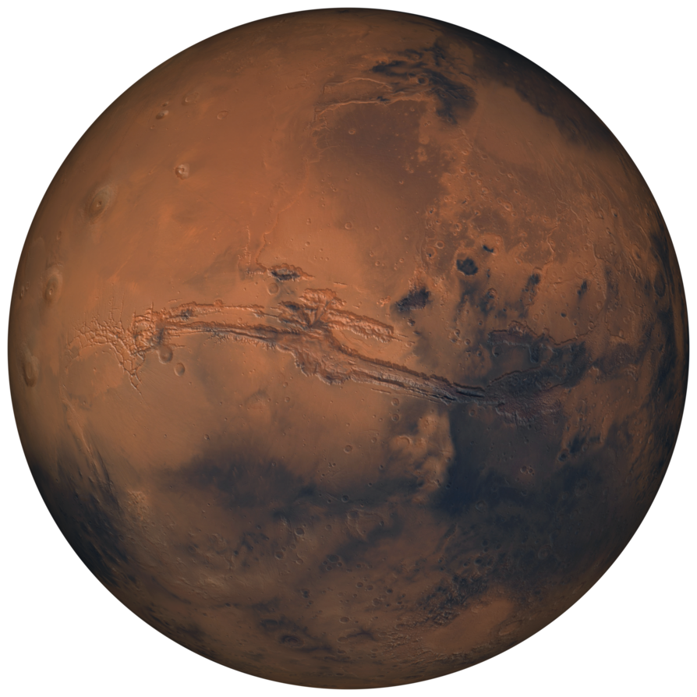


Lucas Baclé, Clément Géhin
Starlink: an overview
$
$

Slide 12
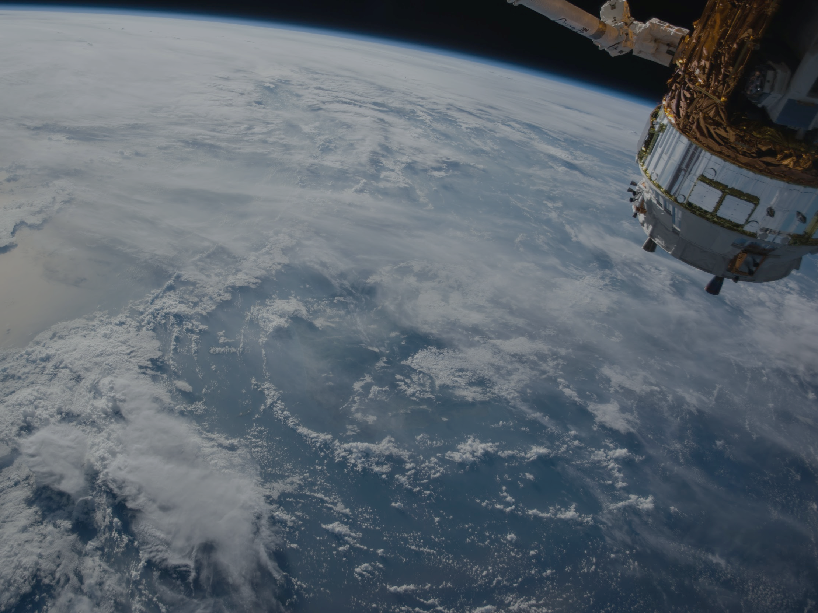
Lucas Baclé, Clément Géhin
Thank you for attending this presentation !

